Slide 1


UNIVERSITY INSTITUTE OF ENGINEERING
COMPUTER SCIENCE & ENGINEERING
Introduction to Information Security and Cryptography
(Subject Code:20CST-354/ITT-354)
Prepared By : Er. Puneet kaur(E6913)
INTRODUCTION
DISCOVER . LEARN . EMPOWER

Slide 2

MD5 message digest algorithm
www. cuchd.in Campus : Gharaun, Mohali

Slide 3
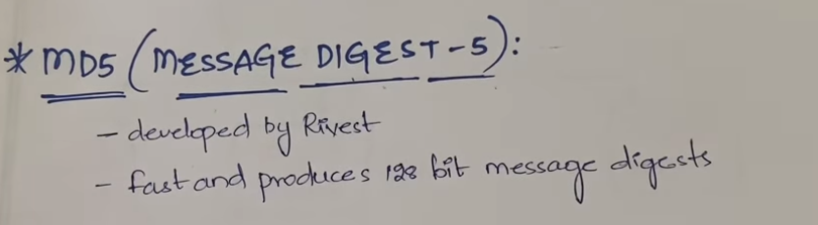

Slide 4
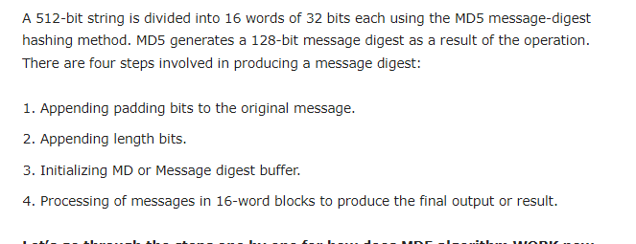

Slide 5
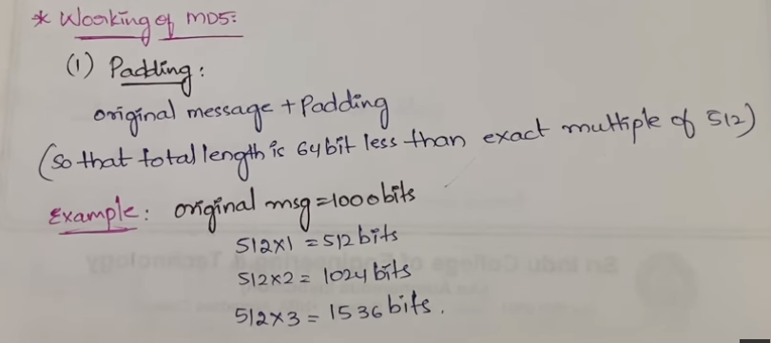

Slide 6
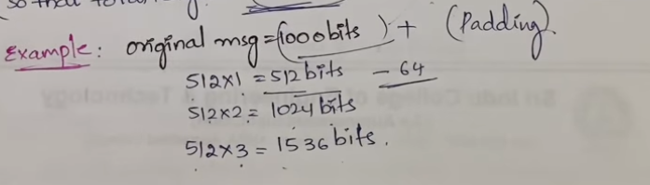

Slide 7
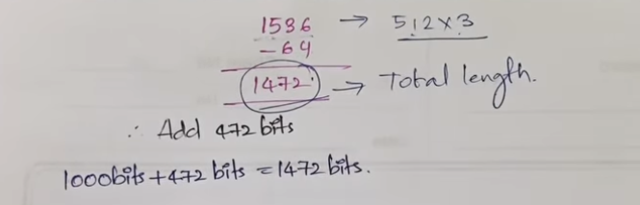

Slide 8
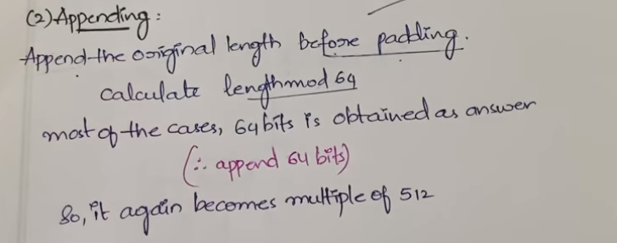

Slide 9
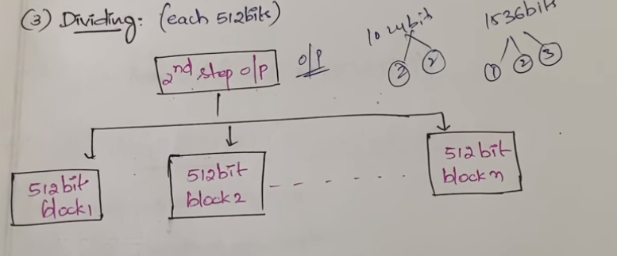

Slide 10
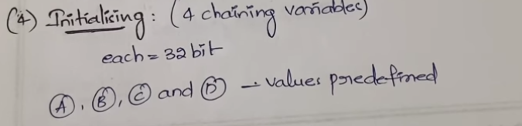

Slide 11
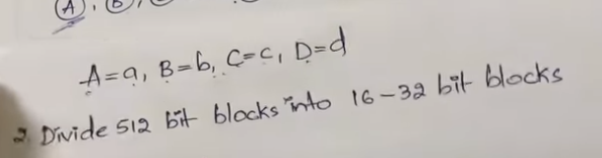

Slide 12
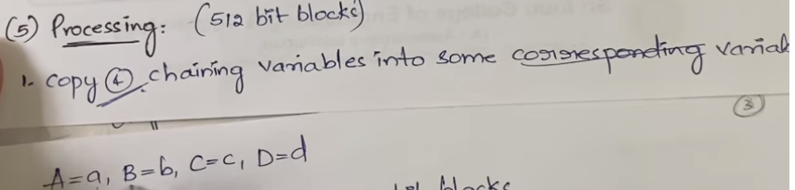

Slide 13
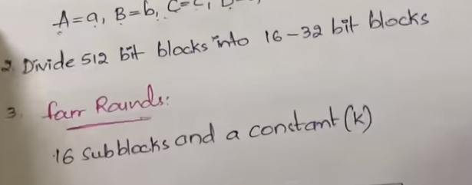

Slide 14
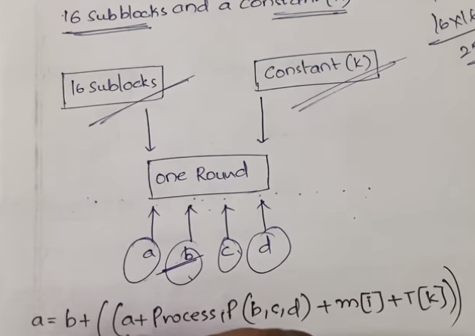

Slide 15
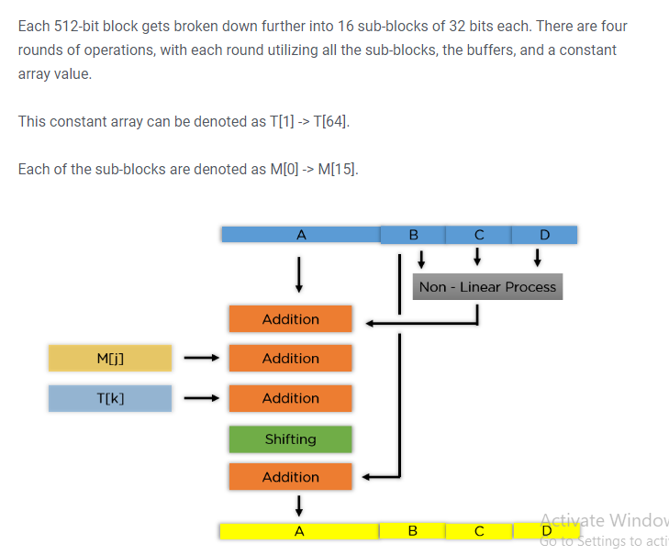

Slide 16
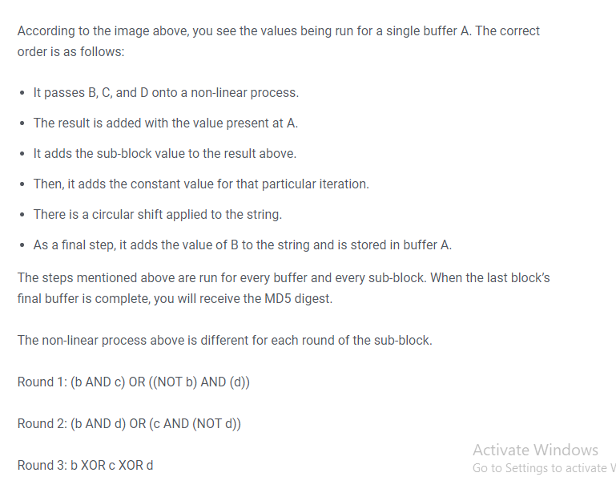

Slide 17
How do the MD5 Algorithm works?
As we all know that MD5 produces an output of 128-bit hash value. This encryption of input of any size into hash values undergoes 5 steps and each step has its a predefined task.

Slide 18
Step1: Append Padding Bits
Padding means adding extra bits to the original message. So in MD5 original message is padded such that its length in bits is congruent to 448 modulo 512. Padding is done such that the total bits are 64 less being a multiple of 512 bits length.
Padding is done even if the length of the original message is already congruent to 448 modulo 512. In padding bits, the only first bit is 1 and the rest of the bits are 0.

Slide 19
Step 2: Append Length
After padding, 64 bits are inserted at the end which is used to record the length of the original input. Modulo 2^64.
At this point, the resulting message has a length multiple of 512 bits.

Slide 20
Step 3: Initialize MD buffer
A four-word buffer (A, B, C, D) is used to compute the values for the message digest. Here A, B, C, D are 32- bit registers and are initialized in the following way
Word A | 01 | 23 | 45 | 67
Word B | 89 | Ab | Cd | Ef
Word C | Fe | Dc | Ba | 98
Word D | 76 | 54 | 32 | 10

Slide 21
Step 4: Processing message in 16-word block
MD5 uses the auxiliary functions which take the input as three 32-bit number and produces a 32-bit output. These functions use logical operators like OR, XOR, NOR.
F(X, Y, Z) | XY v not (X)Z
G(X, Y, Z) | XZ v Y not (Z)
H(X, Y, Z) | X xor Y xor Z
I(X, Y, Z) | Y xor (X v not (Z))

Slide 22
Example
Input: This is an article about the cryptography algorithm
Output: e4d909c290dfb1ca068ffaddd22cbb0

Slide 23
Advantages and Disadvantages of MD5 Algorithm
MD5 Algorithms are useful because it is easier to compare and store these smaller hashes than to store a large text of variable length. It is a widely used algorithm for one way hashes that are used to verify without necessarily giving the original value.MD5 Algorithm is used by Unix systems to store the passwords of the user in a 128-bit encrypted format. MD5 algorithms are widely used to check the integrity of the files.

Slide 24
Advantages and Disadvantages of MD5 Algorithm
Moreover, it is very easy to generate a message digest of the original message using this algorithm. It can perform the message digest of a message having any number of bits, it is not limited to message in the multiples of 8, unlike MD5sum which is limited to octets.

Slide 25
Advantages and Disadvantages of MD5 Algorithm
But from many years MD5 has prone to hash collision weakness, i.e it is possible to create the same hash function for two different inputs. MD5 provides no security over these collision attacks. Instead of MD5, SHA (Secure Hash Algorithm, which produces 160-bit message digest and designed by NSA to be a part of digital signature algorithm) is now acceptable in the cryptographic field for generating the hash function as it is not easy to produce SHA-I collision and till now no collision has been produced yet.

Slide 26
Advantages and Disadvantages of MD5 Algorithm
Moreover, it is quite slow then the optimized SHA algorithm. SHA is much secure than MD5 algorithm and moreover, it can be implemented in existing technology with exceeding rates, unlike MD5. Nowadays new hashing algorithms are coming up in the market keeping in mind higher security of data like SHA256 (which generates 256 bits signature of a text).

Slide 27
References
http://www.brainkart.com/article/Classical-Encryption-Techniques_8339/
https://www.tutorialspoint.com/cryptography/index.htm
https://www.geeksforgeeks.org/cryptography-introduction/
https://www.techopedia.com/definition/1770/cryptography#:~:text=Cryptography%20involves%20creating%20written%20or,information%20to%20be%20kept%20secret.&text=Information%20security%20uses%20cryptography%20on,transit%20and%20while%20being%20stored.
https://www2.slideshare.net/lineking/classical-encryption-techniques-in-network-security?qid=e388c29f-793d-4f2b-bcaf-9d22e9ca07b5&v=&b=&from_search=1

Slide 28
E- Books Recommended
https://www.pdfdrive.com/cyber-security-books.html
https://bookauthority.org/books/new-cyber-security-ebooks
https://bookauthority.org/books/best-cyber-security-ebooks
https://www.freetechbooks.com/information-security-f52.html

